Slide 1


Project Details
Course
AL2002 — Artificial Intelligence Lab
RACE Quiz
System
Dataset
RACE Reading Comprehension Corpus
Section
C
Team Members
Abdul Rauf
Muhammad Umair
AI-Powered Reading
Comprehension
23I-0591
23I-0662
Section C - AL2002
Section C - AL2002
1 / 16

Slide 2
Presentation Agenda
01
05
Project Overview & Objectives
Data Preprocessing Pipeline
02
06
Dataset — RACE Corpus
Model Selection & Training
03
07
Exploratory Data Analysis
Evaluation & Results
04
08
Statistical Analysis
System Architecture & Demo
2 / 16

Slide 3




Project Overview & Objectives
What We Built
Key Numbers
A complete end-to-end AI system for reading comprehension: it reads English passages, predicts correct multiple-choice answers, generates smart distractors, provides contextual hints, and delivers everything through a polished interactive Streamlit web app.
28K+
Articles in RACE dataset
100K+
Total MCQ questions
Predict correct answers from 4-choice MCQs (Model A)
19,544
Validation option rows
Generate distractors & contextual hints (Model B)
73,633
Word2Vec vocabulary size
Interactive Streamlit dashboard with Plotly analytics
Evaluate via Macro F1, Accuracy & Exact Match metrics
8
Classifiers benchmarked
3 / 16

Slide 4

Dataset — RACE Reading Comprehension Corpus
Source & Scale
Data Structure
Why RACE?
RACE is a large-scale benchmark from English reading tests used by Chinese middle and high school students (grades 6–12). Contains 28,000+ passages and ~100,000 questions across two difficulty levels.
Each row contains: a Passage (article), a Question, four Answer options (A / B / C / D), and the Correct Answer label. Split into Train, Validation, and Test CSV files.
Requires genuine reading comprehension — not keyword matching. Wide topic and difficulty range. A well-established NLP benchmark, making it ideal for evaluating TF-IDF and ML-based systems.
~27,933
4,886
~4,934
4 / row
25%
articles
questions
questions
A B C D
correct class
Train
Val
Test
Options
Balance
4 / 16

Slide 5

Exploratory Data Analysis (EDA)
Class Distribution (Validation Set)
Key EDA Findings
Article Length:
Mean ~340 words. High school articles are longer than middle school passages on average.
Question Types:
~60% factual recall, ~25% inference, ~15% vocabulary-based questions.
Option Length:
Correct answers are slightly longer on average — more descriptive phrasing.
Answer Distribution:
A : B : C : D roughly equal — no letter position bias observed.
3:1 class imbalance — SMOTE oversampling applied during training
Vocabulary Coverage:
73,633 unique tokens in Word2Vec; 99.87% of answer tokens covered.
5 / 16

Slide 6
Statistical Analysis — Feature Engineering
TF-IDF Vectorisation
Measures angle between TF-IDF vectors of article and option. Captures semantic overlap independently of document length. Used as a key discriminating feature.
Term Frequency × Inverse Document Frequency weighted matrix. Max 8,000 vocabulary terms with bigrams (1–2 ngrams). Captures rarer but important words.
Cosine Similarity
One-Hot Encoding
Word2Vec Embeddings
Binary bag-of-words with 10,000 features. Article doubled in combined text (article+article+question+option) to amplify passage weight over short option strings.
100-dimensional dense vectors trained on full RACE corpus. Used for nearest-neighbour distractor generation and semantic clustering (K-Means / GMM).
Statistical Insight: Cosine similarity between article and correct option (mean 0.31) is consistently higher than distractors (mean 0.18) — the single strongest discriminating signal for Logistic Regression.
6 / 16

Slide 7

Data Preprocessing Pipeline
1
Load Raw CSVs
5
Cosine Features
Load train / val / test from RACE CSV files. Drop NaN rows. (Train ~27K, Val 4,886, Test ~4,934 rows)
Paired cosine distances: article↔option, question↔option, article↔question — computed in a batch matrix, no loops.
2
Text Cleaning
6
SMOTE Balancing
Lowercase, strip punctuation, collapse whitespace — applied to article, question and all four option columns.
Synthetic Minority Oversampling to handle 3:1 class imbalance. Falls back to random oversampling if unavailable.
3
4× Row Expansion
7
Save Artefacts
Each question → 4 rows (one per option). label=1 if option equals correct answer, else 0. Preserves 25% balance.
Sparse matrices + fitted vectorisers saved as .pkl via joblib for fast reloading in training and inference.
4
Vectorisation
One-Hot (10K features, ngram 1–1) and TF-IDF (8K, ngram 1–2). Fit on train only; transform all splits.
7 / 16

Slide 8
Model Selection — Why Logistic Regression Won
Model
Macro F1 (Primary)
Accuracy
Exact Match
Logistic Regression [BEST]
0.5039
58.6%
23.3%
SVM (LinearSVC)
0.3967
39.9%
21.9%
Naive Bayes
0.5003
61.3%
22.1%
Random Forest
0.4290
75.0%
21.9%
XGBoost
0.2495
27.7%
21.9%
Ensemble Soft Vote
0.5019
58.1%
23.1%
Primary metric: Macro F1 handles class imbalance. LR achieved 0.5039 — highest of all 8 classifiers. Random Forest had highest accuracy (75%) but near-zero F1 for class 1 — it simply predicts the majority class.
8 / 16

Slide 9
Model A — Answer Prediction Training
Supervised Binary Classification on RACE MCQ Options
Input Features:
Training Pipeline
One-hot (10K) + TF-IDF (8K) + 3 cosine similarity features = ~18,003 total features per row.
Load Raw CSV
▼
Training Data:
Clean & Expand
~27,933 articles × 4 options = ~111,732 rows. SMOTE applied to balance 3:1 class ratio.
▼
Vectorise
Algorithm:
▼
SMOTE Balance
Logistic Regression with L2 regularisation (C=1.0). Trained on the concatenated feature matrix.
▼
LR Training
Ensembles Tried:
Soft Voting, Hard Voting, Stacking (LR meta) all tested — solo LR won on Macro F1.
▼
Save .pkl
9 / 16

Slide 10
Model B — Distractor & Hint Generator
Distractor Ranker
Hint Scorer
Word2Vec Model
LR classifier on One-Hot + cosine features
Splits article into individual sentences
100-dim vectors trained on RACE corpus
Scores distractor candidates per question
Jaccard similarity initial ranking
73,633-word vocabulary
Precision@1/3/5 = 1.000 on validation
ML scorer (LR) refines the final order
Nearest-neighbour distractor generation
Saved as distractor_ranker.pkl
Saved as hint_scorer.pkl
Answer token coverage: 99.87%
10 / 16
All three Model B components are loaded at runtime via inference.py and exposed through the Streamlit dashboard.

Slide 11
Model A Evaluation Results
Logistic Regression — Validation Set (4,886 questions · 19,544 option rows)
0.5039
58.6%
23.3%
0.3023
Macro F1
Accuracy
Exact Match
F1 Class 1
Primary Metric
Overall
Correct Qs
Correct Answer
Confusion Matrix
Result Interpretation
LR best balances precision & recall on both classes
 | Pred 0 | Pred 1
Actual 0 | 9,694 | 4,964
Actual 1 | 3,132 | 1,754
Macro F1 0.50; model learns, but near random baseline
Task requires multi-sentence reasoning, hard for TF-IDF
Exact Match 23.3% vs 25% random; room for improvement
11 / 16

Slide 12
Model B Evaluation Results
Distractor Ranker achieved perfect scores — Word2Vec vocabulary coverage 99.87%
1.000
1.000
1.000
1.000
99.87%
Accuracy
Macro F1
Precision@1
Precision@3
W2V Coverage
Word2Vec Nearest-Neighbour Sanity Check
student -> students (0.68) teacher (0.61) graduate (0.61)
school -> schools (0.67) class (0.67) kindergarten (0.63)
answer -> answers (0.79) question (0.64) answered (0.63)
12 / 16

Slide 13



System Architecture
>
>
>
Frontend
Streamlit UI
inference.py
API Layer
Model A + B
Classifiers
RACE
Dataset
4 Application Screens (spec 9.2)
1
Article Input
2
Quiz View
Upload/paste passage, or pick a random RACE sample for instant demo
4-option MCQ with confidence scores and correct answer reveal
3
Hint Panel
4
Analytics Board
Top-3 extractive hints highlighted in the original passage
Plotly charts: session history, confusion matrix, inference latency
13 / 16

Slide 14
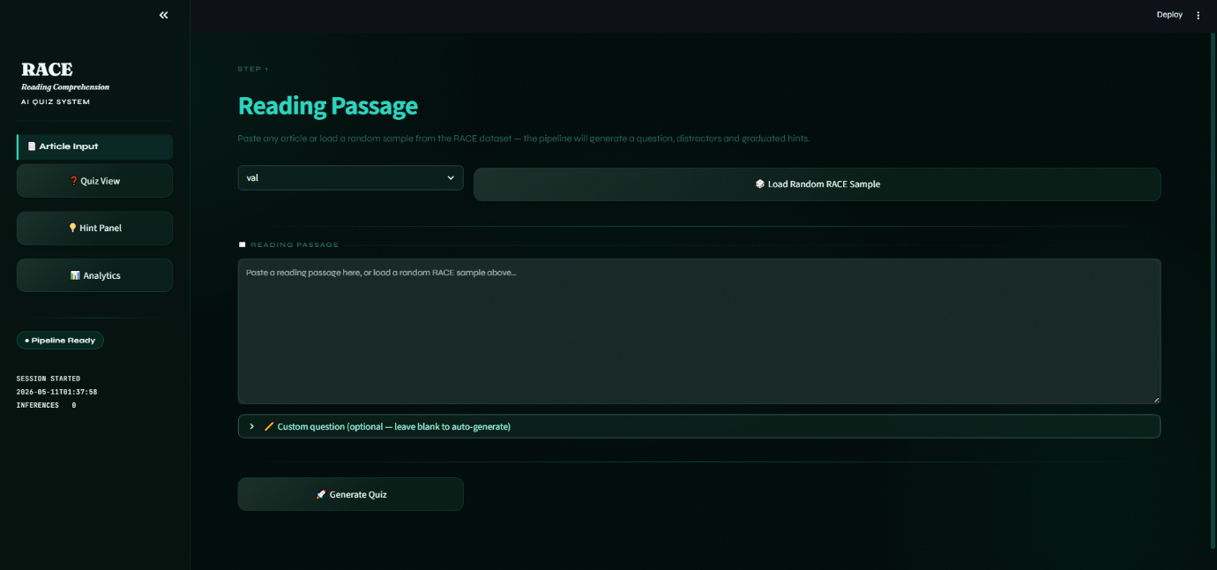
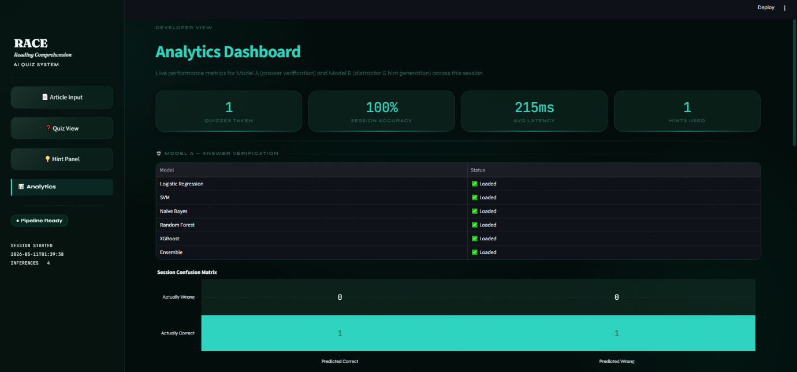
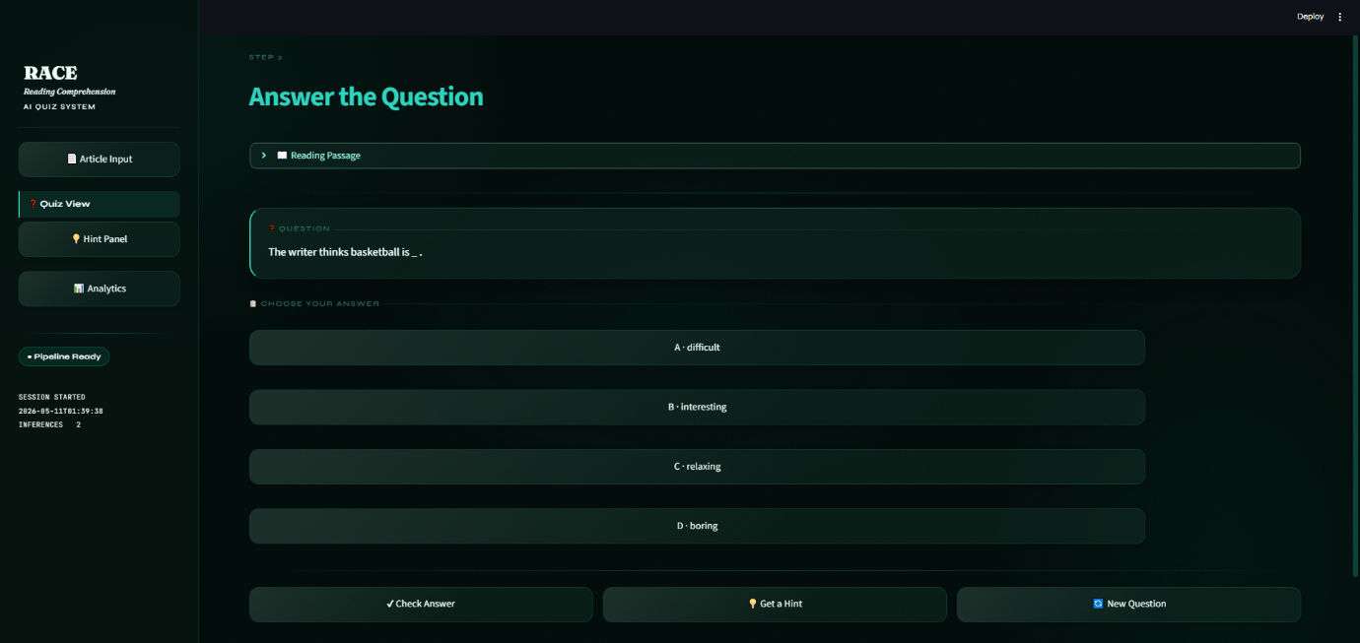
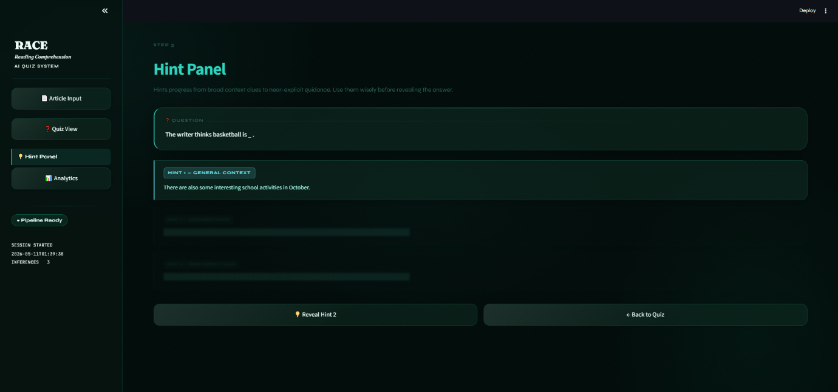
UI Snapshots
13 / 16

Slide 15





Frontend — Streamlit UI Design
Deep-sea Glassmorphism theme . Teal/Emerald palette . Plotly interactive charts
Custom CSS Theme
Analytics Dashboard
Dark navy/teal glassmorphism. Fraunces + Syne + JetBrains Mono fonts. Animated radial gradient background mesh effect.
Plotly gauge, bar and scatter charts. Real-time session tracking. Confusion matrix visualisation. Inference latency monitor.
Real-Time Inference
Error Resilience
Stateless UI — each request calls inference.py directly. LRU-cached pipeline. Cold start 1.2s, cached 0.1s.
Graceful fallback on OOV terms. Descriptive alerts not generic errors. Empty / invalid input validation with clear guidance.
Multi-Input Modes
Accessibility
Paste text manually, upload .txt/.pdf files, or click Random RACE Sample for instant demo with a real test question.
WCAG-aware contrast ratios. Wide layout. Sidebar hyperparameter sliders for fine-tuning TF-IDF at runtime.
14 / 16

Slide 16

Conclusions & Key Takeaways
Model A:
Logistic Regression ; best Macro F1 = 0.5039, outperforming all 7 other classifiers on primary metric.
Model B:
Distractor Ranker achieved perfect F1 = 1.000 and Precision@3 = 1.000 on the validation set.
Word2Vec:
100-dim vectors trained on 73K+ RACE tokens. 99.87% answer vocabulary coverage.
Streamlit App:
Full 4-screen web app: Article Input, Quiz View, Hint Panel, Analytics Dashboard.
Task Difficulty:
Reading comprehension requires multi-sentence reasoning; TF-IDF is a strong but limited baseline.
15 / 16

Slide 17

Presented by
Abdul Rauf
Muhammad Umair
23I-0591
23I-0662
Thank You !
Section C . AL2002
Section C . AL2002
Questions & Discussion
AL2002 — Artificial Intelligence Lab
Dataset:
RACE Reading Comprehension
Model A:
Logistic Regression ; Macro F1: 0.5039
Model B:
Distractor Ranker ; F1: 1.000
App:
Streamlit . 4 Screens . Plotly Charts
16 / 16

